Slide 1
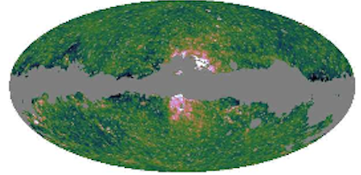
On the Milky Way Haze and Dark Matter
Elena Pierpaoli (Univ. of Southern California)
Andrey Egorov (USC), Davide Pietrobon (Berkely), Jennifer Gaskins (Univ. of Amsterdam)

Slide 2
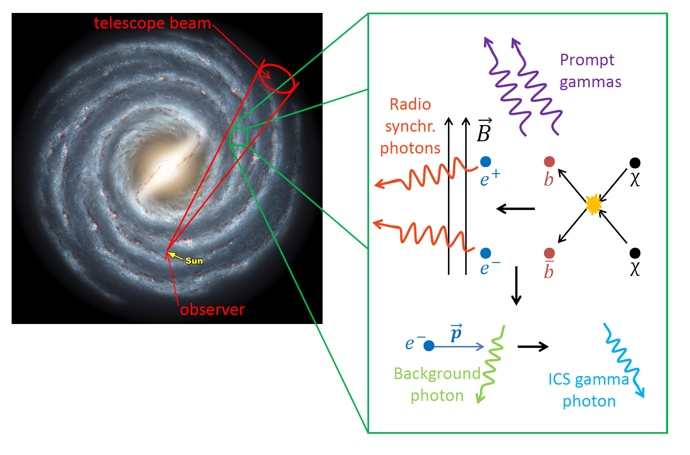
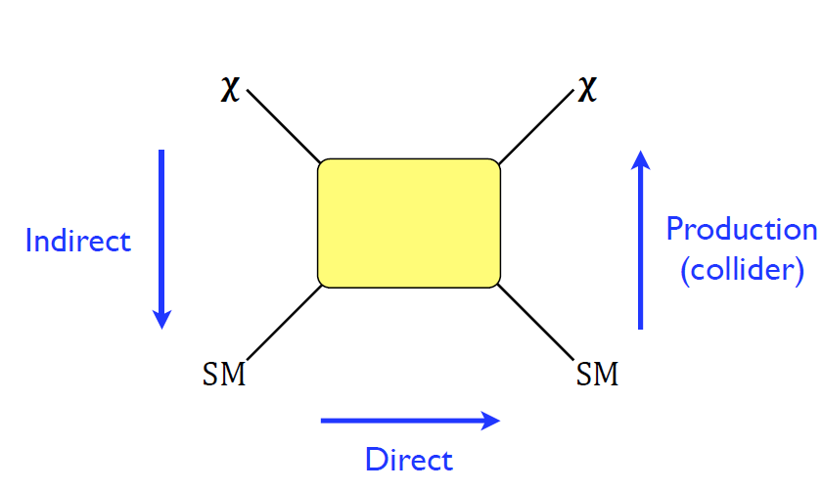
Our work – indirect searches, Milky Way, microwave

Slide 3
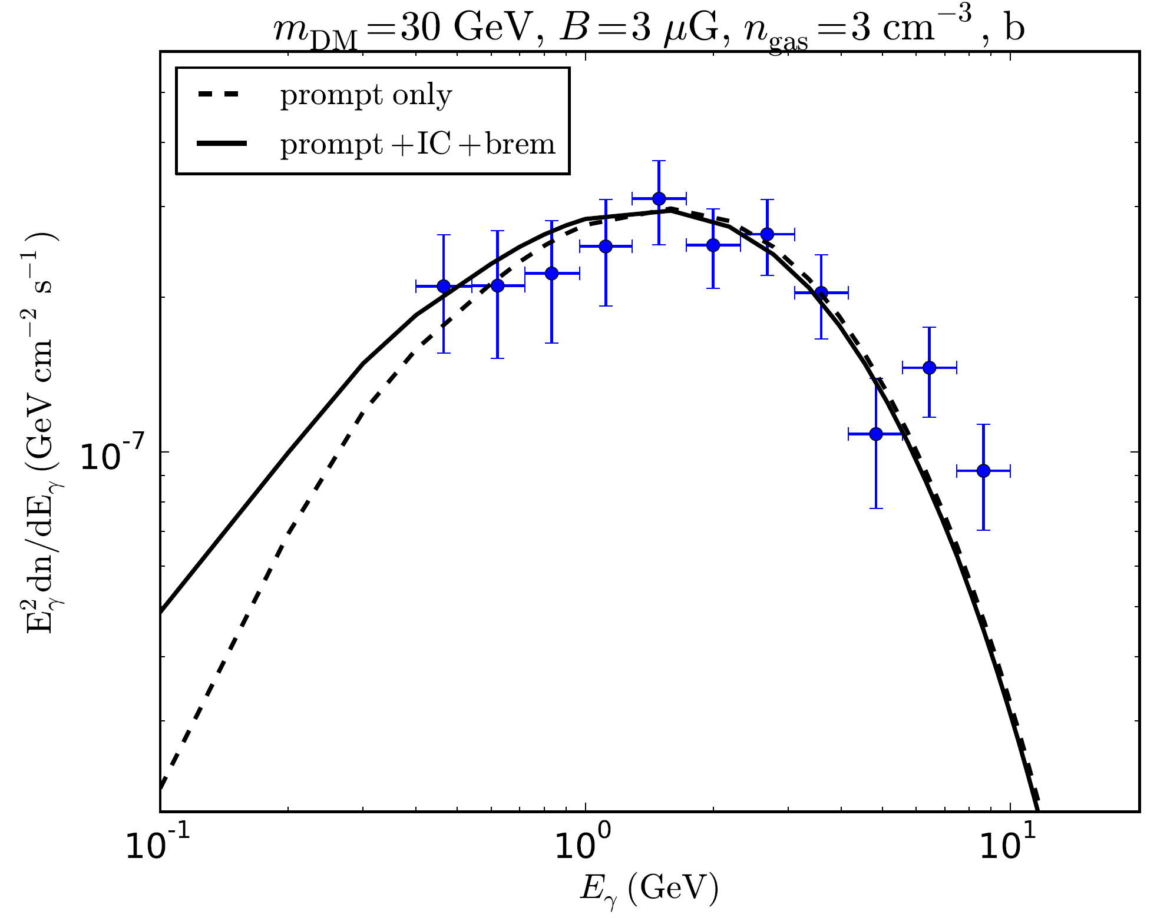
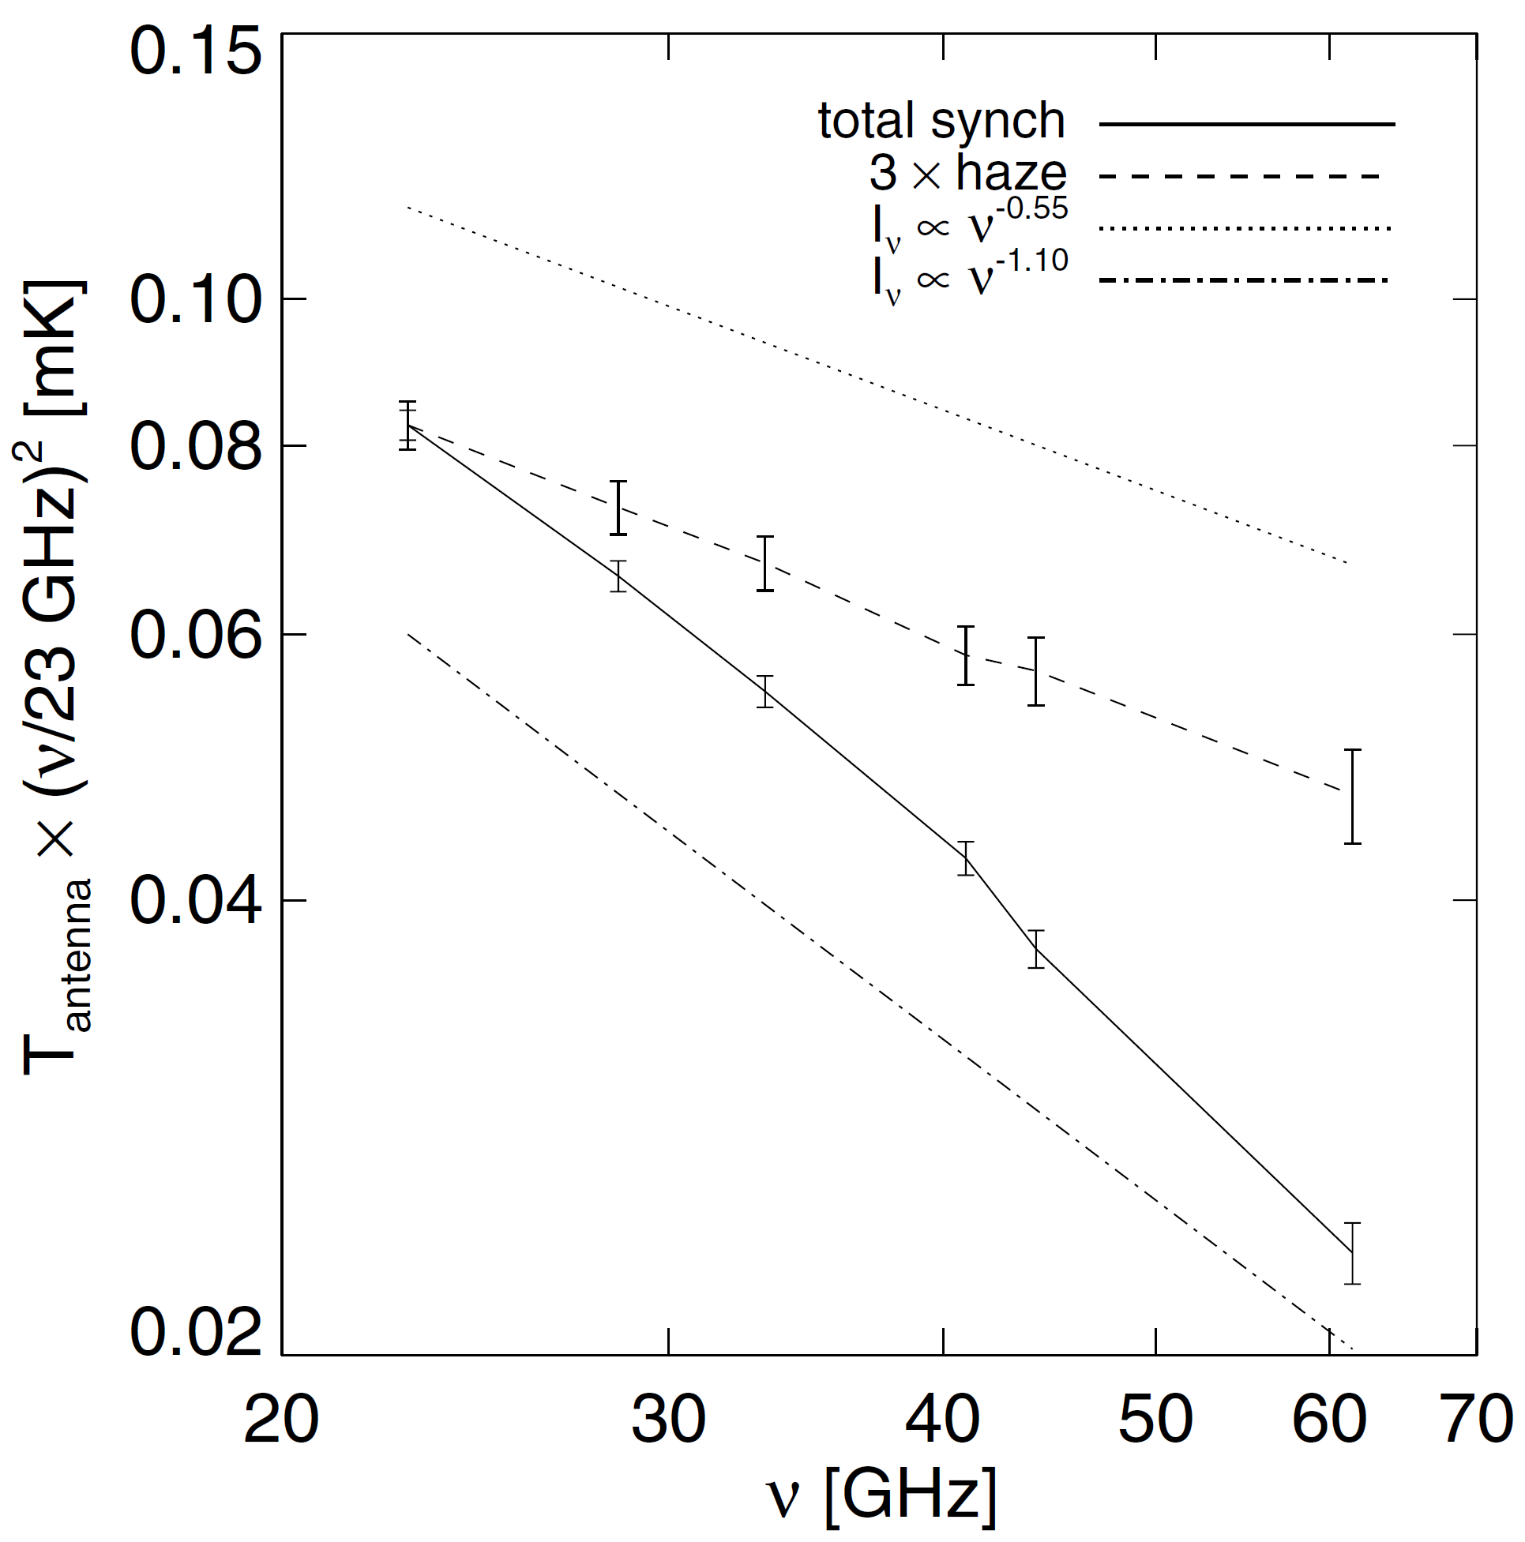
Motivation: gamma and microwave excesses around GC
Planck
Strange excess
or haze (tripled)
Fermi gamma
excess data
Regular synchrotron
DM fits of
the excess
An example of fit of the gamma excess around the GC by annihilating DM with parameters specified (<σv>≈2.0e-26 cm^3/s) — taken from T.Lacroix et al.,Phys. Rev. D 90, 043508 (2014). The dashed line shows the prompt emission only from DM, the solid one — prompt together secondary from DM leptons.
Total synchrotron emission spectrum and its unknown Haze component as observed by WMAP/Planck (region of the sky |l|<35°, -35°<b<-10°) — from Planck Team. The unknown Haze has a distinct spectral index -2.56 instead of -3.1 for “usual” synchrotron from CRs.
Planck Haze paper: arXiv 1208.5483

Slide 4
Questions
Is there evidence for an anomalous microwave signal?
Do we know what contributes to it?
Is there a “need” for DM in interpreting it?
Is there any favored DM model?

Slide 5
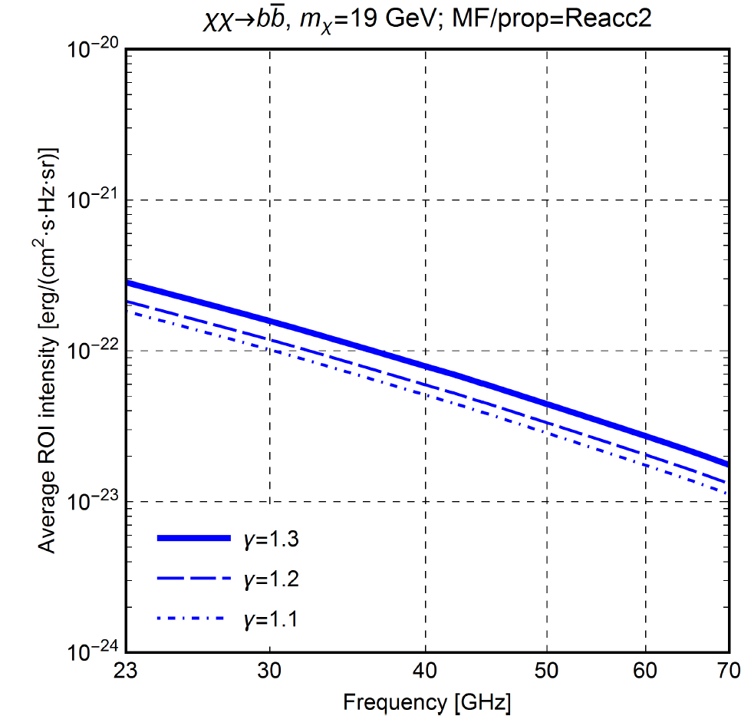
Dark matter density distribution
According to the fits of the GC gamma excess,
we employed the generalized NFW profile:
α = 1, β = 3
rs = 23 kpc (also matches Galactic kinematics)
Normalized according to
All the results were computed for 3 relevant values of the inner slope γ: 1.1, 1.2 and 1.3.
The profile was also truncated below the Schwarzschild radius of the central BH to avoid its unphysical divergence.
DM substructures were also included besides the smooth component above. But they implied a mild enhancement – (30-35)% - of the DM intensity in the ROI due to tidal disruptions in the GC vicinity.
An example of the DM intensity dependence on
the inner profile slope γ. We can see a relatively
minor dependence (about 50% in intensity at all
frequencies) .

Slide 6
Magnetic field distribution
B0 = 6 μG – a well-know field value in the Solar vicinity;
B(0,0) = 50,100 μG – the GC robust lower limit and an optimistic case;
zB ~ h – the diffusion zone half-height, zB had discrete values ≈(2-7) kpc.
Thus, various versions were computed to cover evenly the respective uncertainty range.
A typical example.

Slide 7
Propagation of DM leptons
- DM leptons source term
We modified the GALPROP package (www.galprop.stanford.edu) public version to enable a comprehensive DM functionality.
Lepton injection spectra dNe/dp were implemented from respective particle physics data at PPPC4DIM resource www.marcocirelli.net/PPPC4DMID.html
The propagation was done in 3 spatial dimensions (with 200 pc resolution along each), 1 time and 1 momenta dimensions.
Univ. of Southern California computing cluster was employed to run 300 DM/MF/prop models in total.
DM emission sky maps were also generated by GALPROP in HEALPix format.

Slide 8
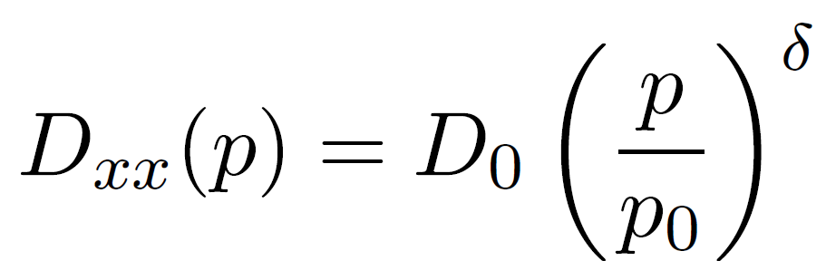
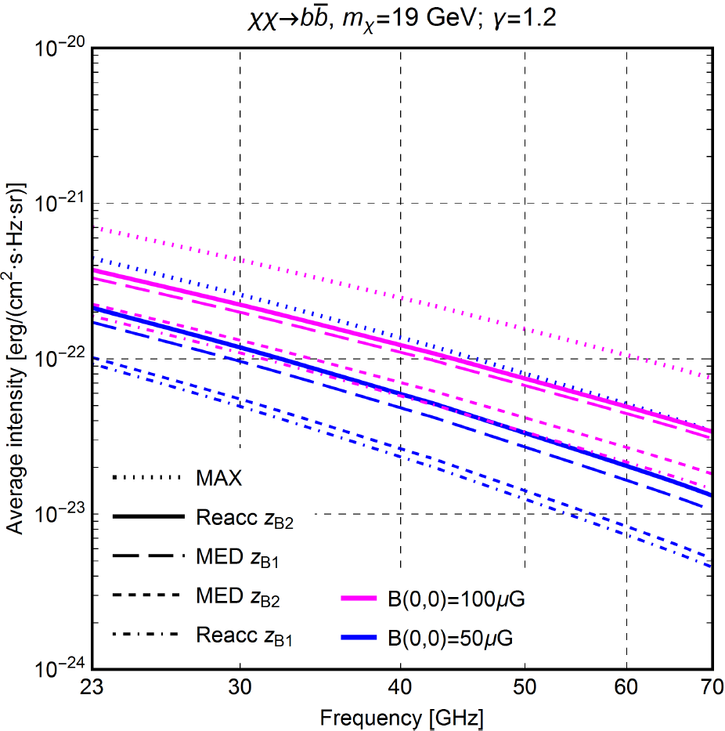
Propagation of DM leptons - 2
- the spatial diffusion
coefficient
- the lepton reacceleration coefficient
All the results were computed for 3 different diffusion models, which are expected to cover the relevant uncertainty range well. We used the canonical MED,MAX models and the newer one with the particle reacceleration based on recent GALPROP team studies.

Slide 9
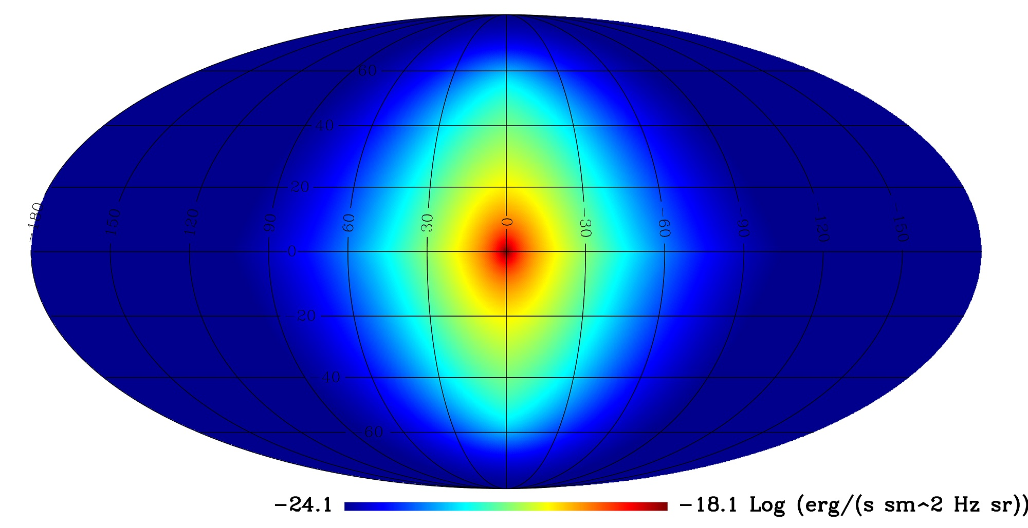
DM emission: all sky 23 GHz map of the best-fitting model.

Slide 10
Changing frequency
Plotted: 1-I/I_bf

Slide 11
Changing particle mass

Slide 12
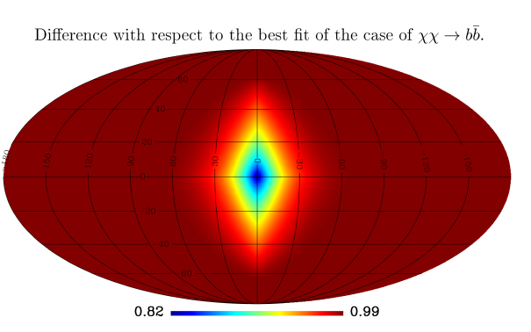
Changing annihilation channel

Slide 13
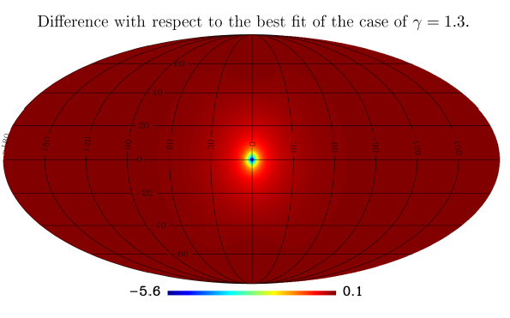
Changing DM density slope

Slide 14
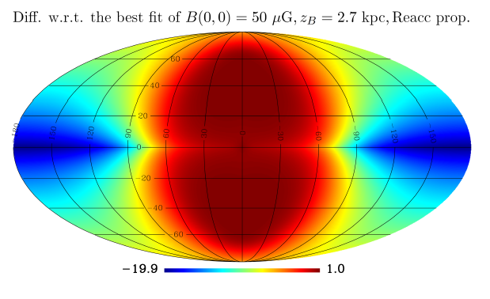
Changing magnetic field and diffusion

Slide 15
Procedures applied
METHOD I: Conservative estimate: Overall upper limit to the DM signal (ignoring foregrounds and considering only the CMB)
METHOD II: Less conservative estimate: Template fitting procedure (therefore including foreground subtraction) – results depend on assumptions on foregrounds and specific method adopted.
Intermediate step: single frequency fitting.

Slide 16
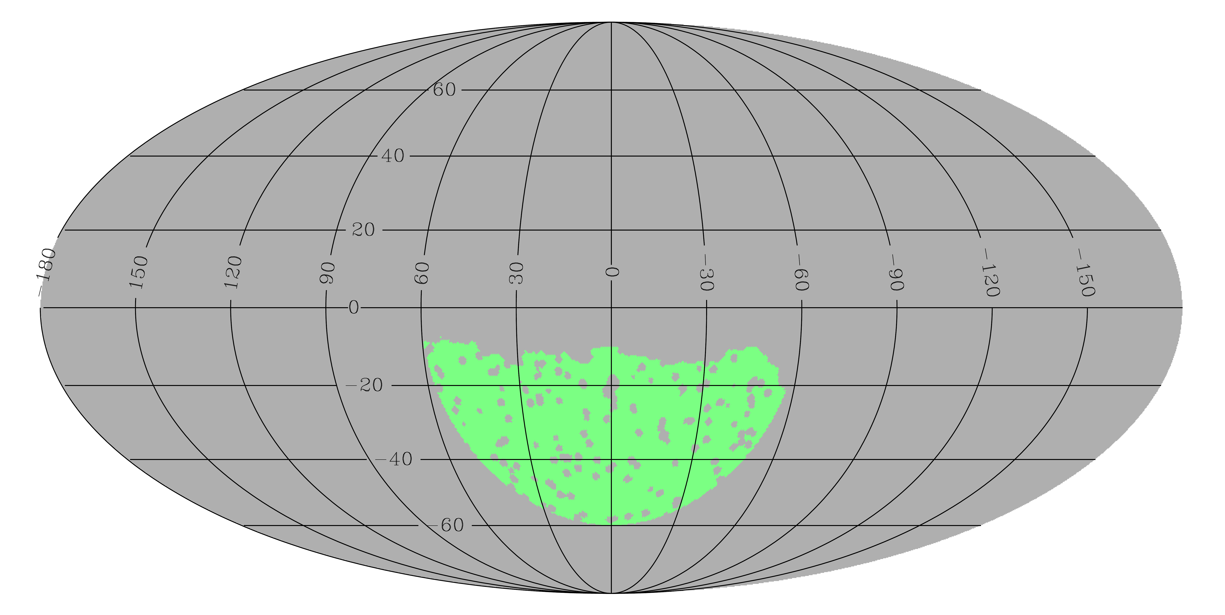
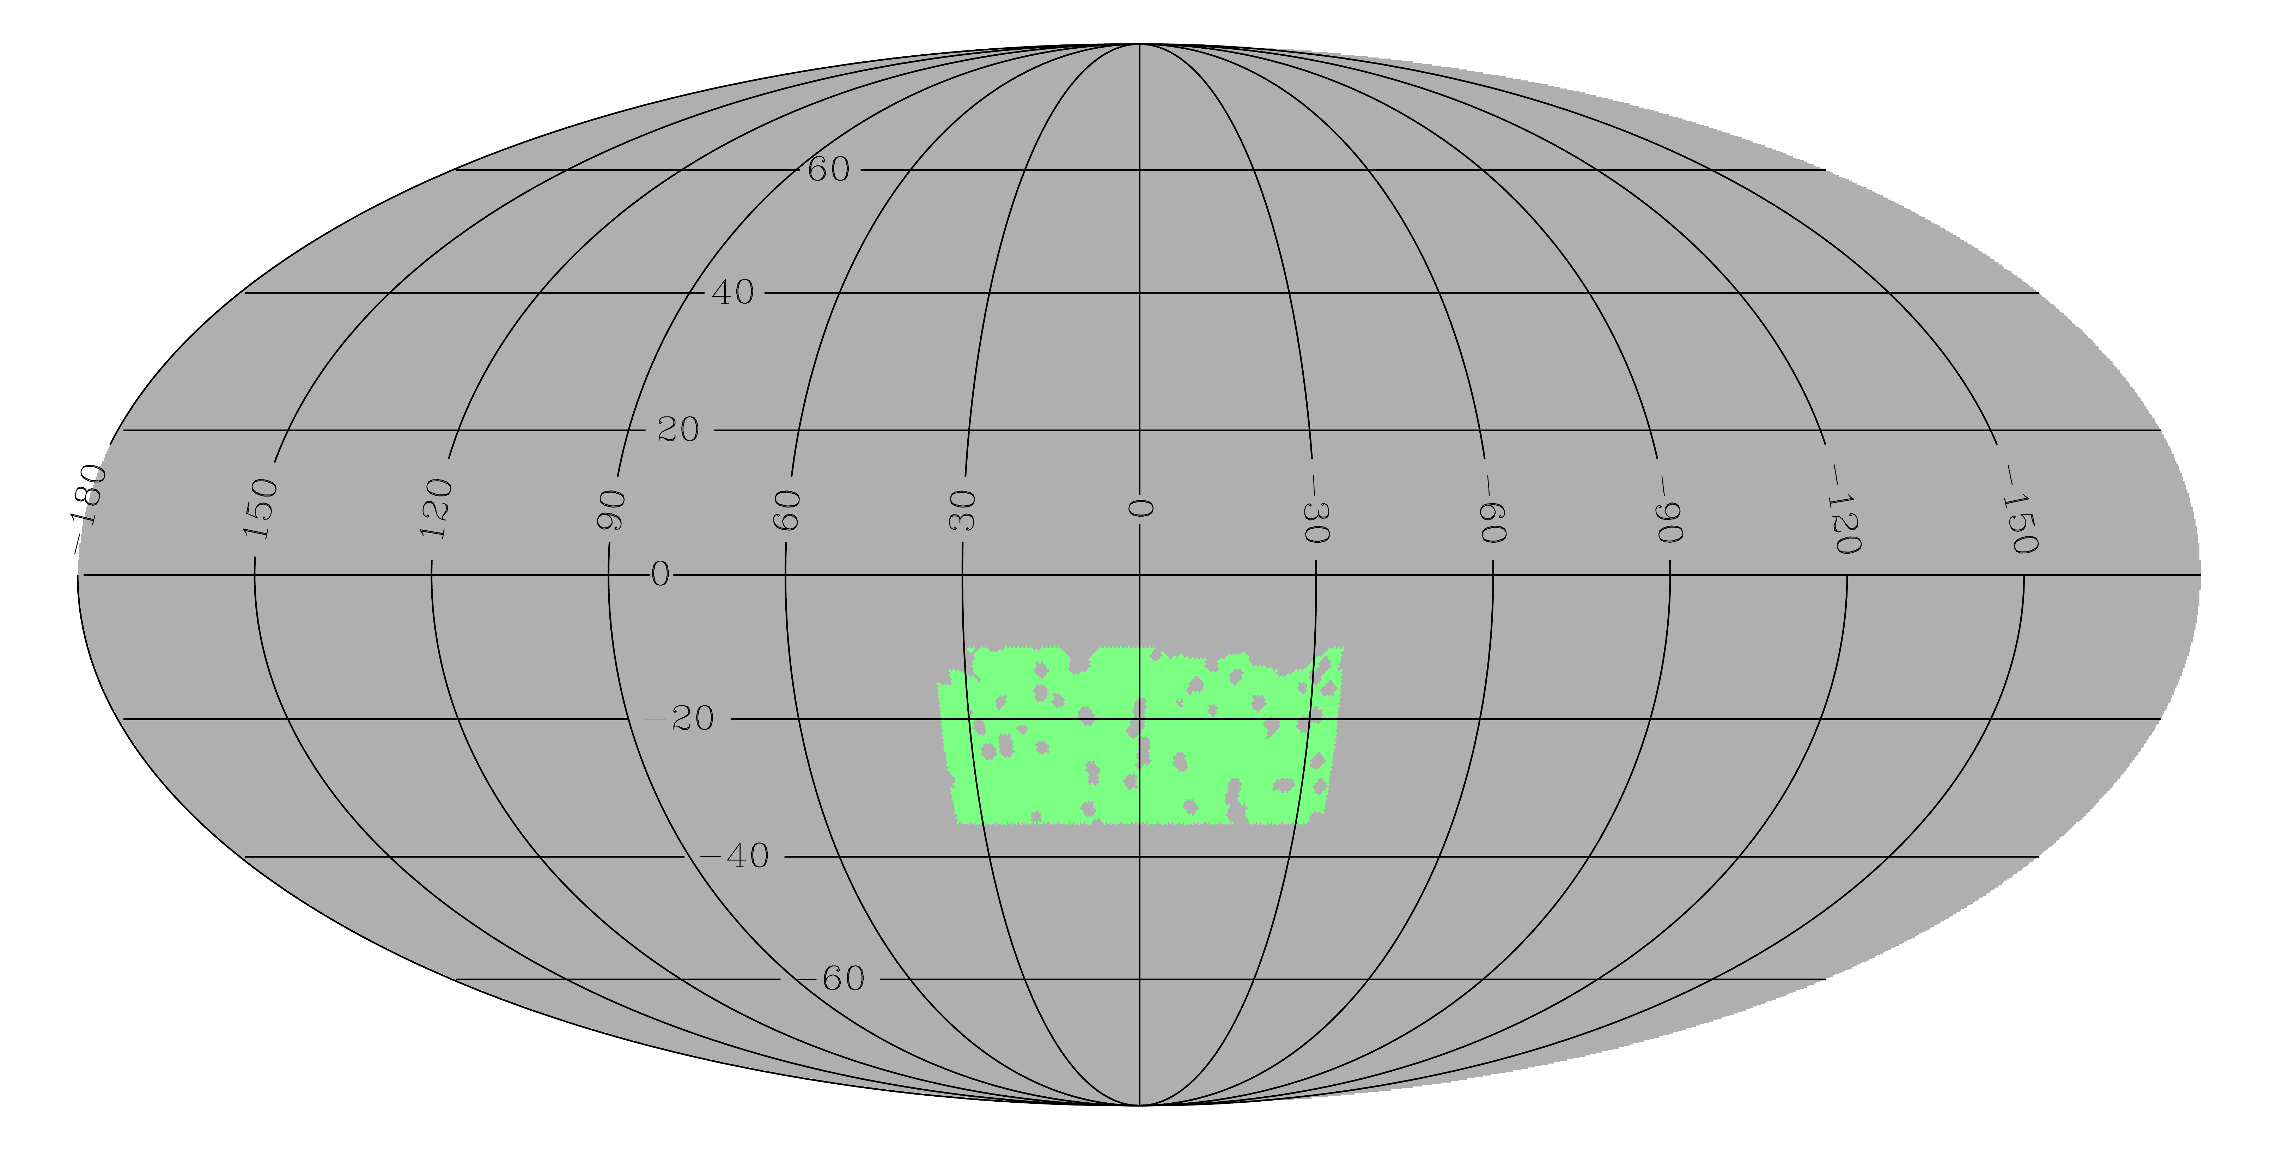
Choice of the area inspected
METHOD II:
60 deg circle from the galactic center.
Galactic and point sources maps applied.
METHOD I:
-35<b<-10 deg;
mod(l) < 35 deg
Galactic and point sources maps applied.

Slide 17
Method I (considering CMB fluctuations only)
For each frequency channel (28, 44 and 70 GHz), we subtract residual monopole and dipole, and we calculate the average intensity and error.
The error has three components: residual monopole and dipole, and CMB.
We calculate the 95%CL for the intensity at each frequency, and required that the DM model emission in the area should not exceed any of these.
By doing so, we derived a conservative limit on the cross-section.

Slide 18
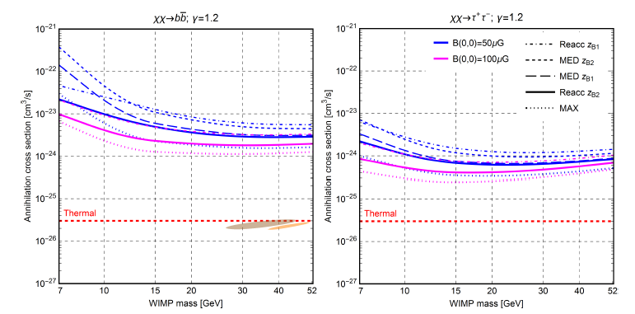
Results of method I
Exclusion plots for cross section well above thermal values.
Stronger constraints for tau+/tau- channel.
Very mild dependence on inner slope (not reported here)
Stronger constraints for high magnetic fields.
Notes:
Brown region: Gordon and Marcias, 2013
Orange: Dylan et al 2014

Slide 19
Method II (with foreground subtraction)
Multi-frequency template fitting of:
CMB [ILC map from HFI channels]
Free-free [H_alpha map]
Synchrotron [Haslam 408MHz]
Dust [SFD]
“Bubbles”
MCMC (assuming Gaussian Likelihood) to derive amplitudes of the various components, without assuming a frequency dependence for any (aside from CMB and the DM one)
DM maps for each model and frequency computed with GALPROP.
Data: 4 WMAP (23,33,41,61 GHz) and 3 Planck LFI (23, 44, 70 GHz) 2013 temperature maps.

Slide 20
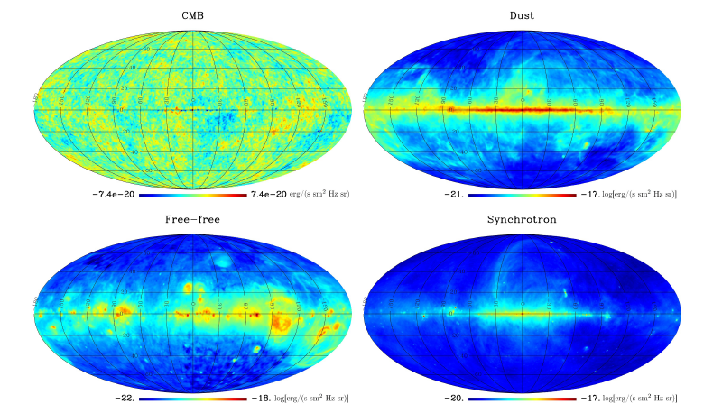
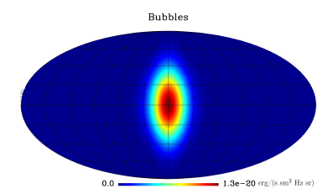
Foreground maps
“Bubbles”: Elliptical Gaussian template with width:
Sigma_l= 15 deg
Sigma_b = 25 deg
The choice of the Bubbles component matches Dobler et al 2012

Slide 21
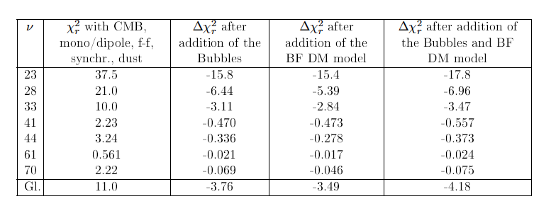
Reduced c² - considerations
Fits are, in general, poor: red. C² between 6.80 and 7.03 for all models. Work on simulations showed that C² were coming out fine when we tried to recover what was actually in the simulations; so there must be something we are still missing.
Effect of the addition of Bubbles and/or DM: improvement with each, and better if both considered.
Preference for high B values, m~19GeV and vertically elongated DM contribution to the signal, and intermediate frequency spectra among those produced by DM.

Slide 22
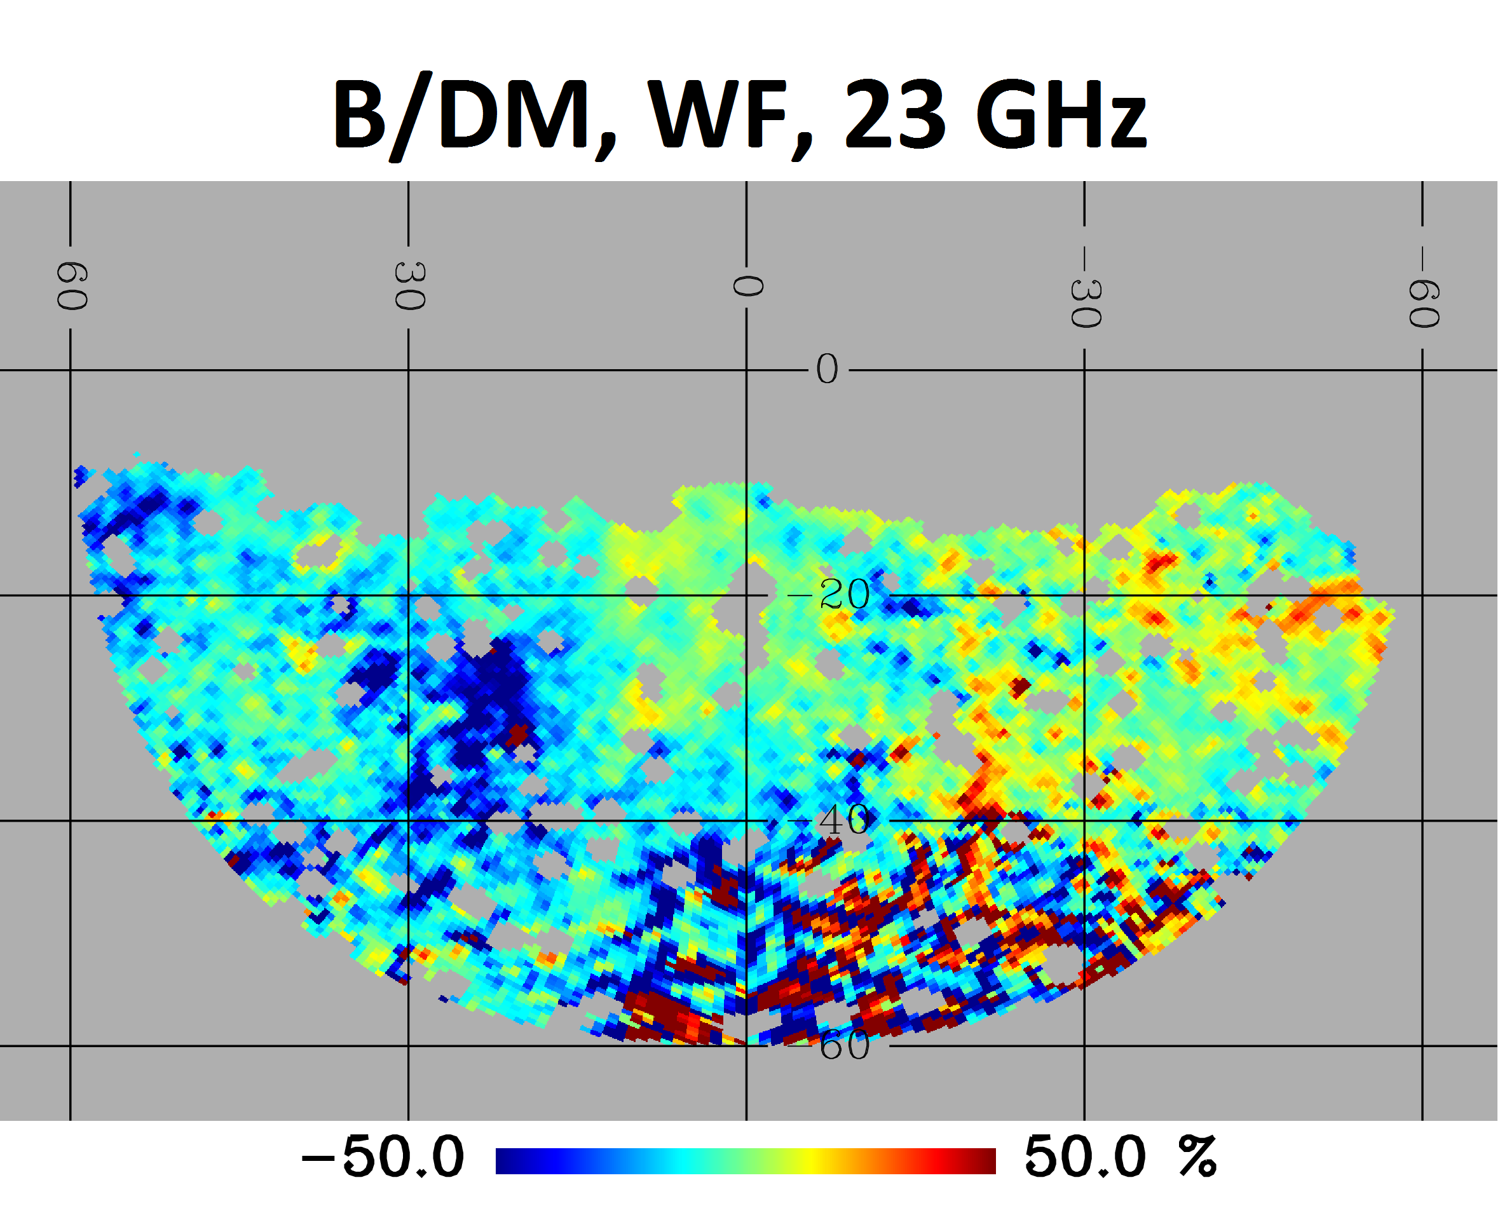
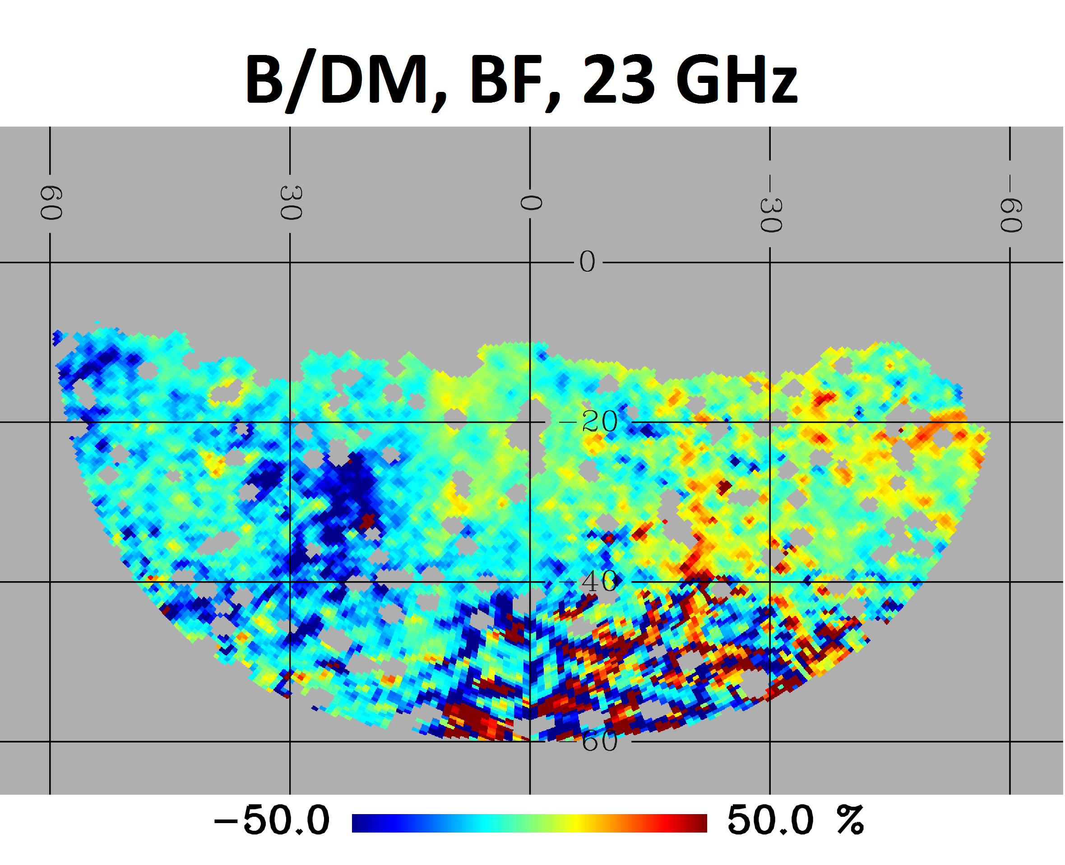
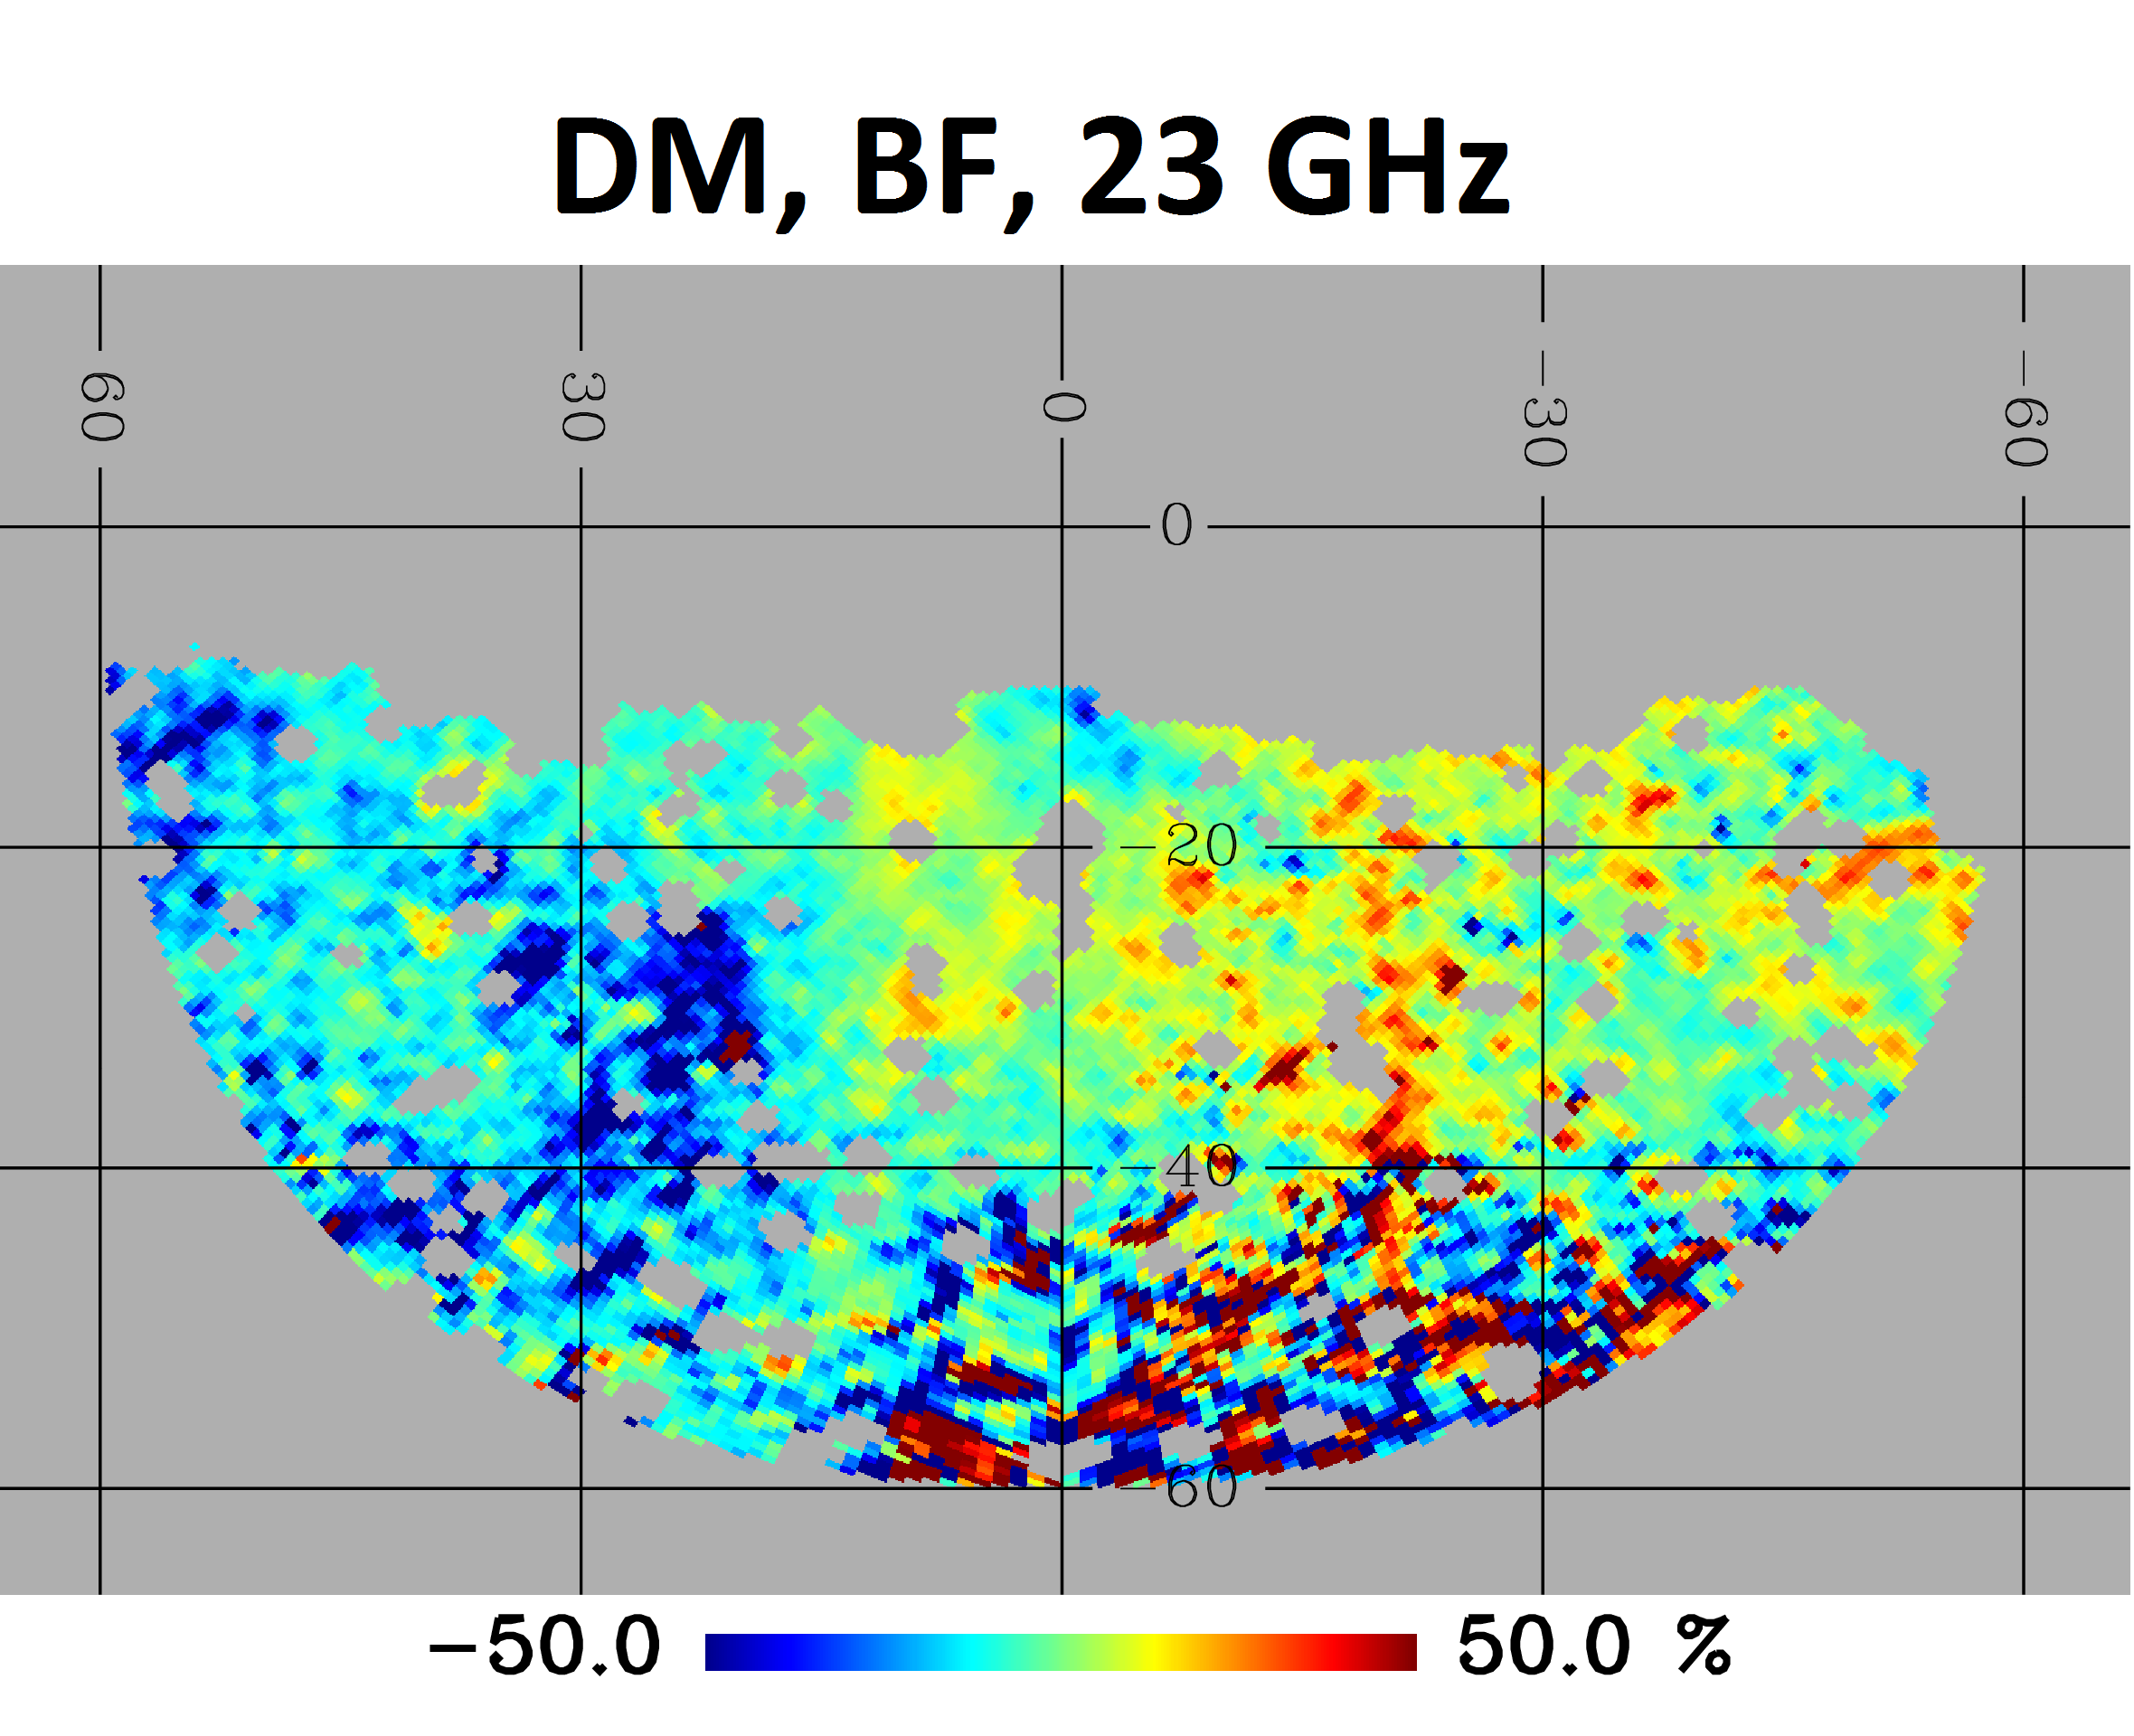
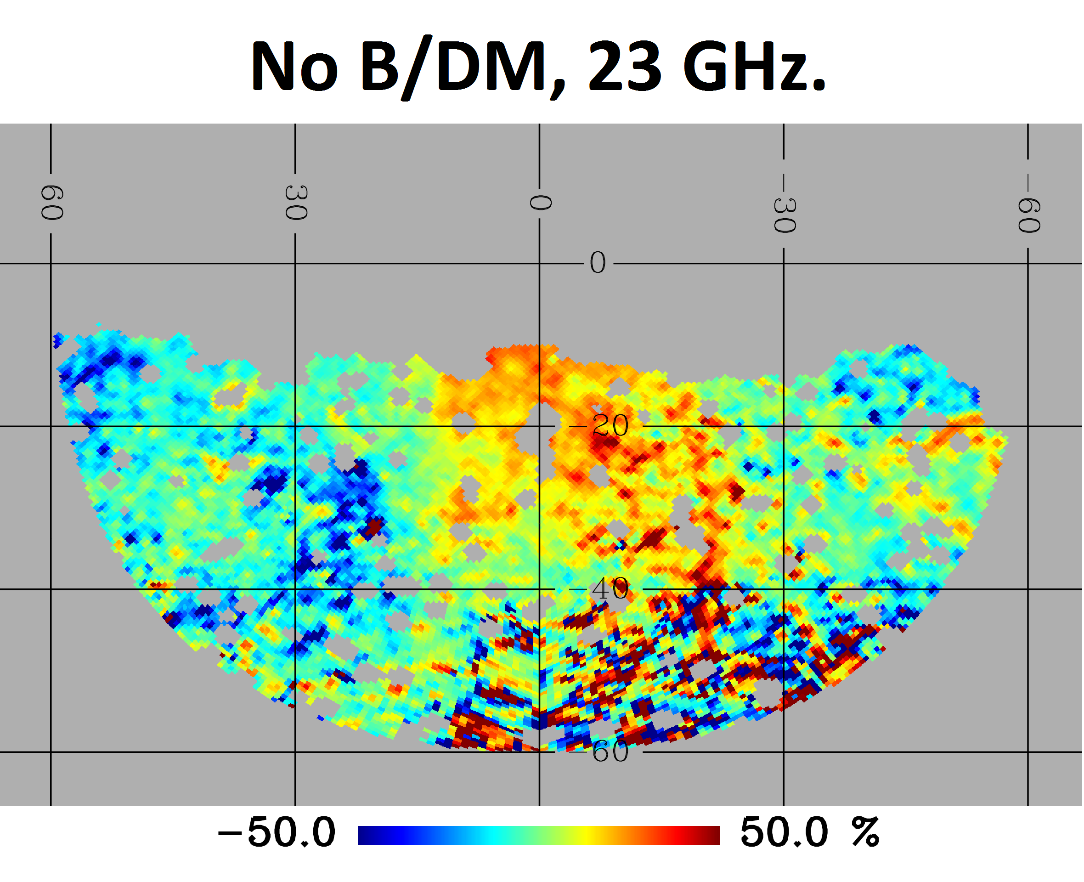
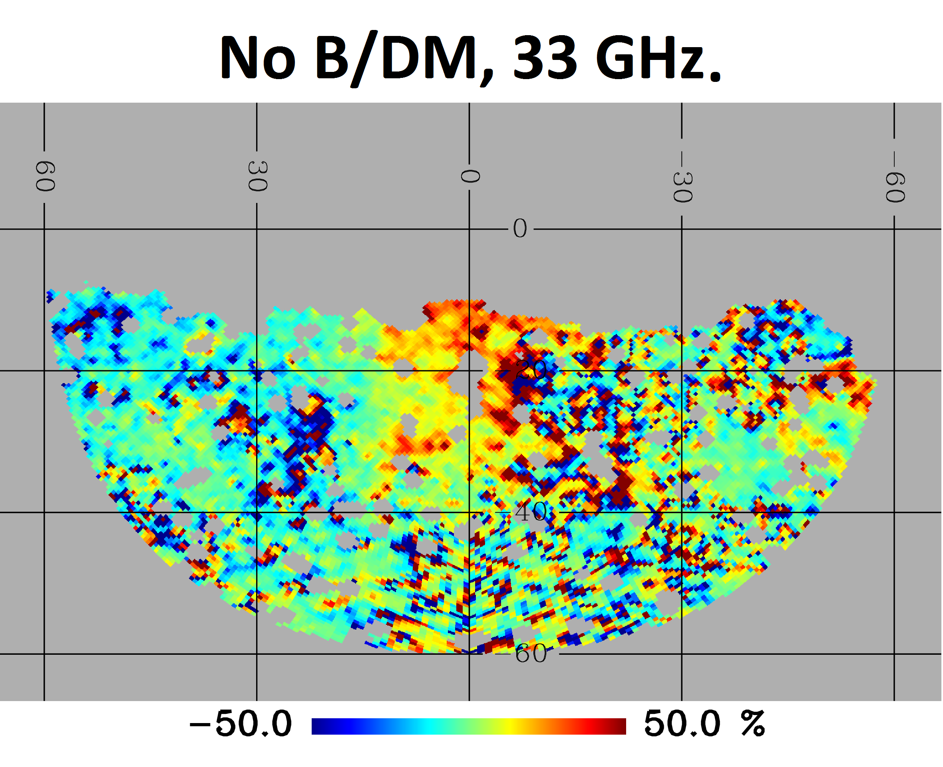
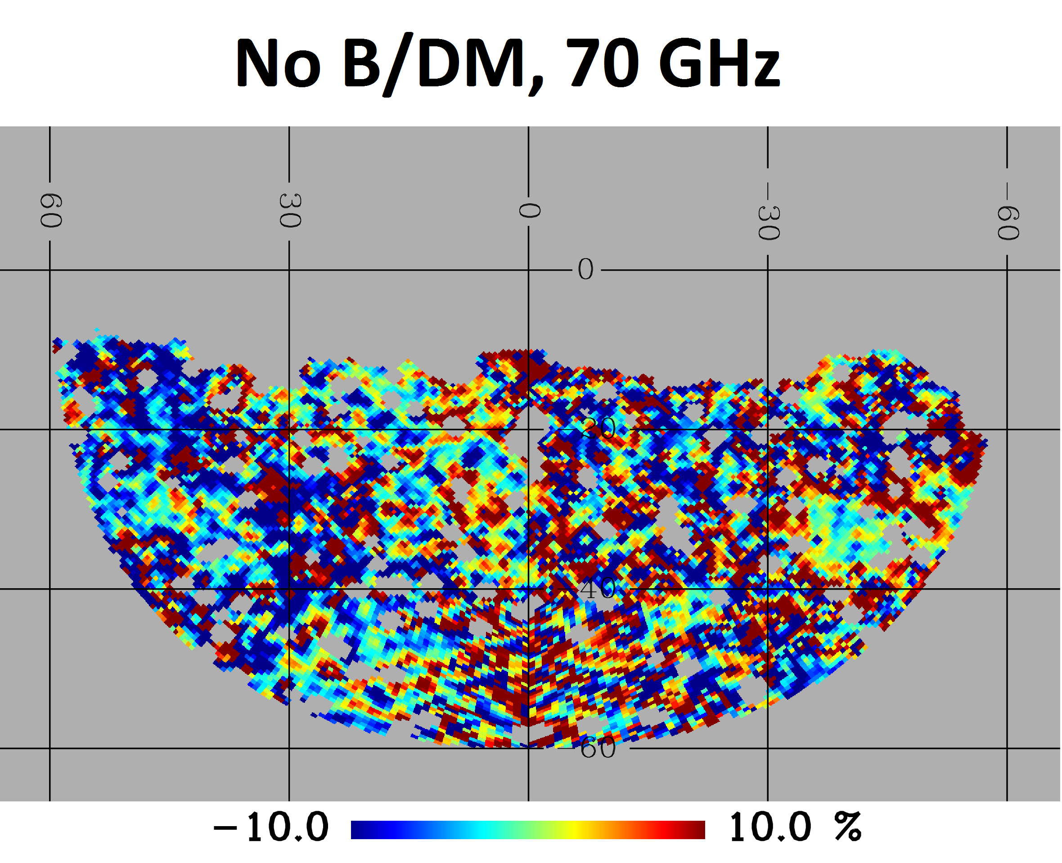
Residuals - maps
No B or DM: Haze visible mainly at low frequencies
Adding B and also DM improves the fit, but no much difference between the best of worst model.

Slide 23
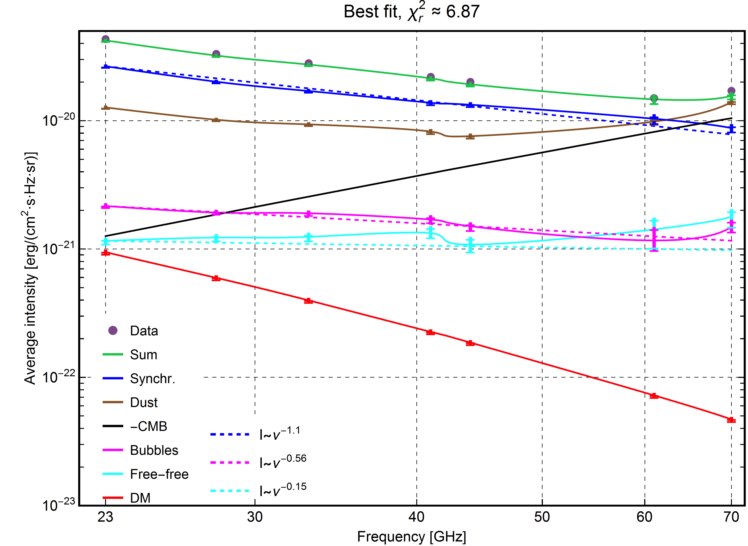
Frequency dependence
In general, frequency dependence for the varius components I s correctly recovered.
DM: smallest contribution to the data (0.2-2%)
Haze: 7.3% at 23 GHz

Slide 24
DM contributions to the signal
Haze contribution to the data: 6-7% (lower than estimated in Planck paper:23% at 23 GHz. Probably due to the different area considered.)
DM contribution: ~0.5-2% of total signal and 6-21% of the Haze.

Slide 25
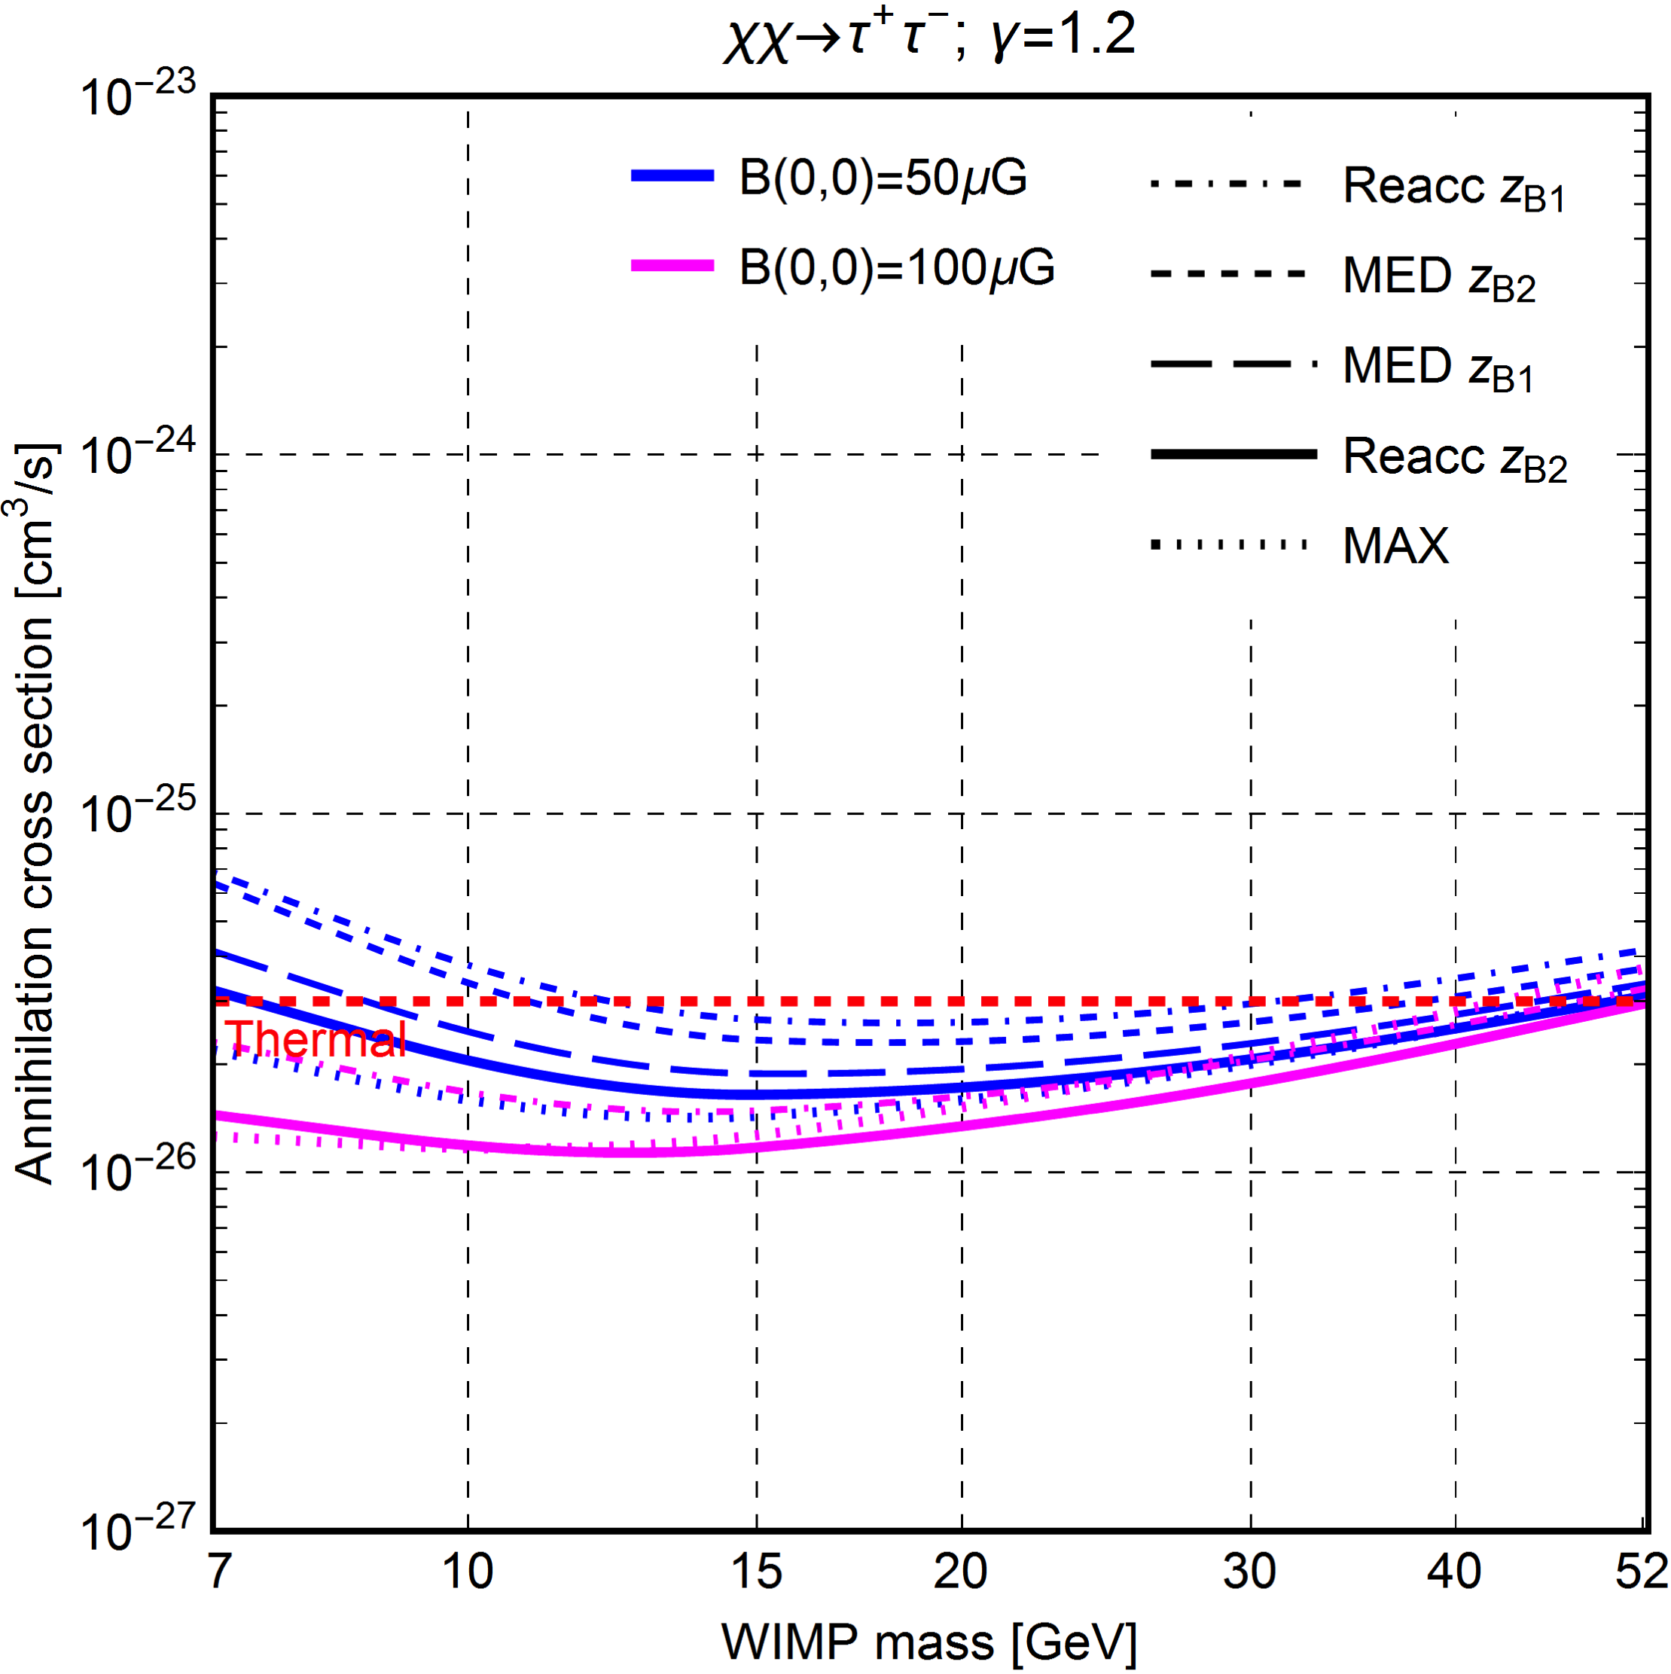
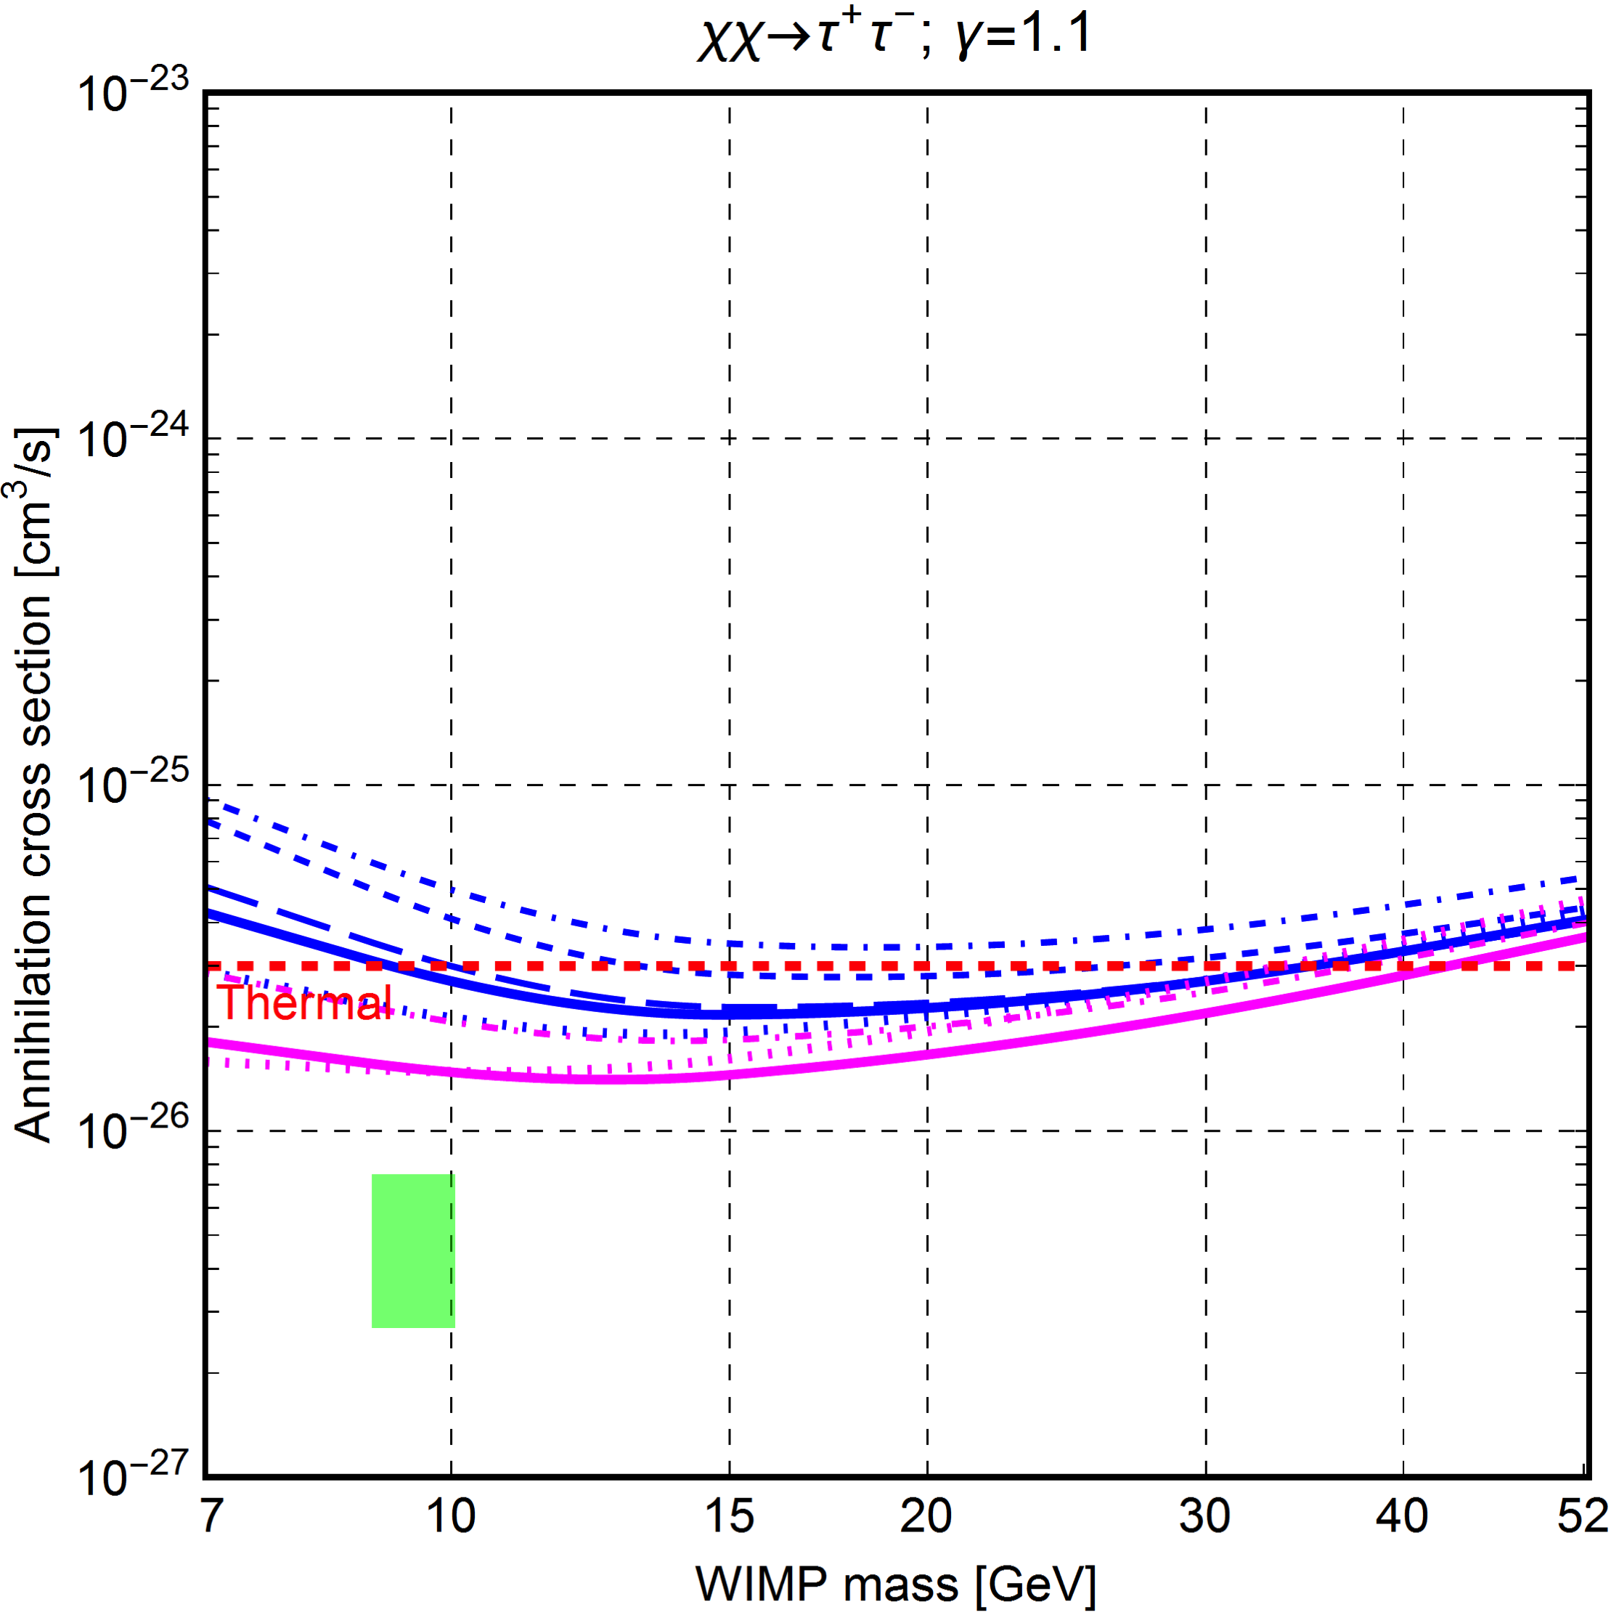
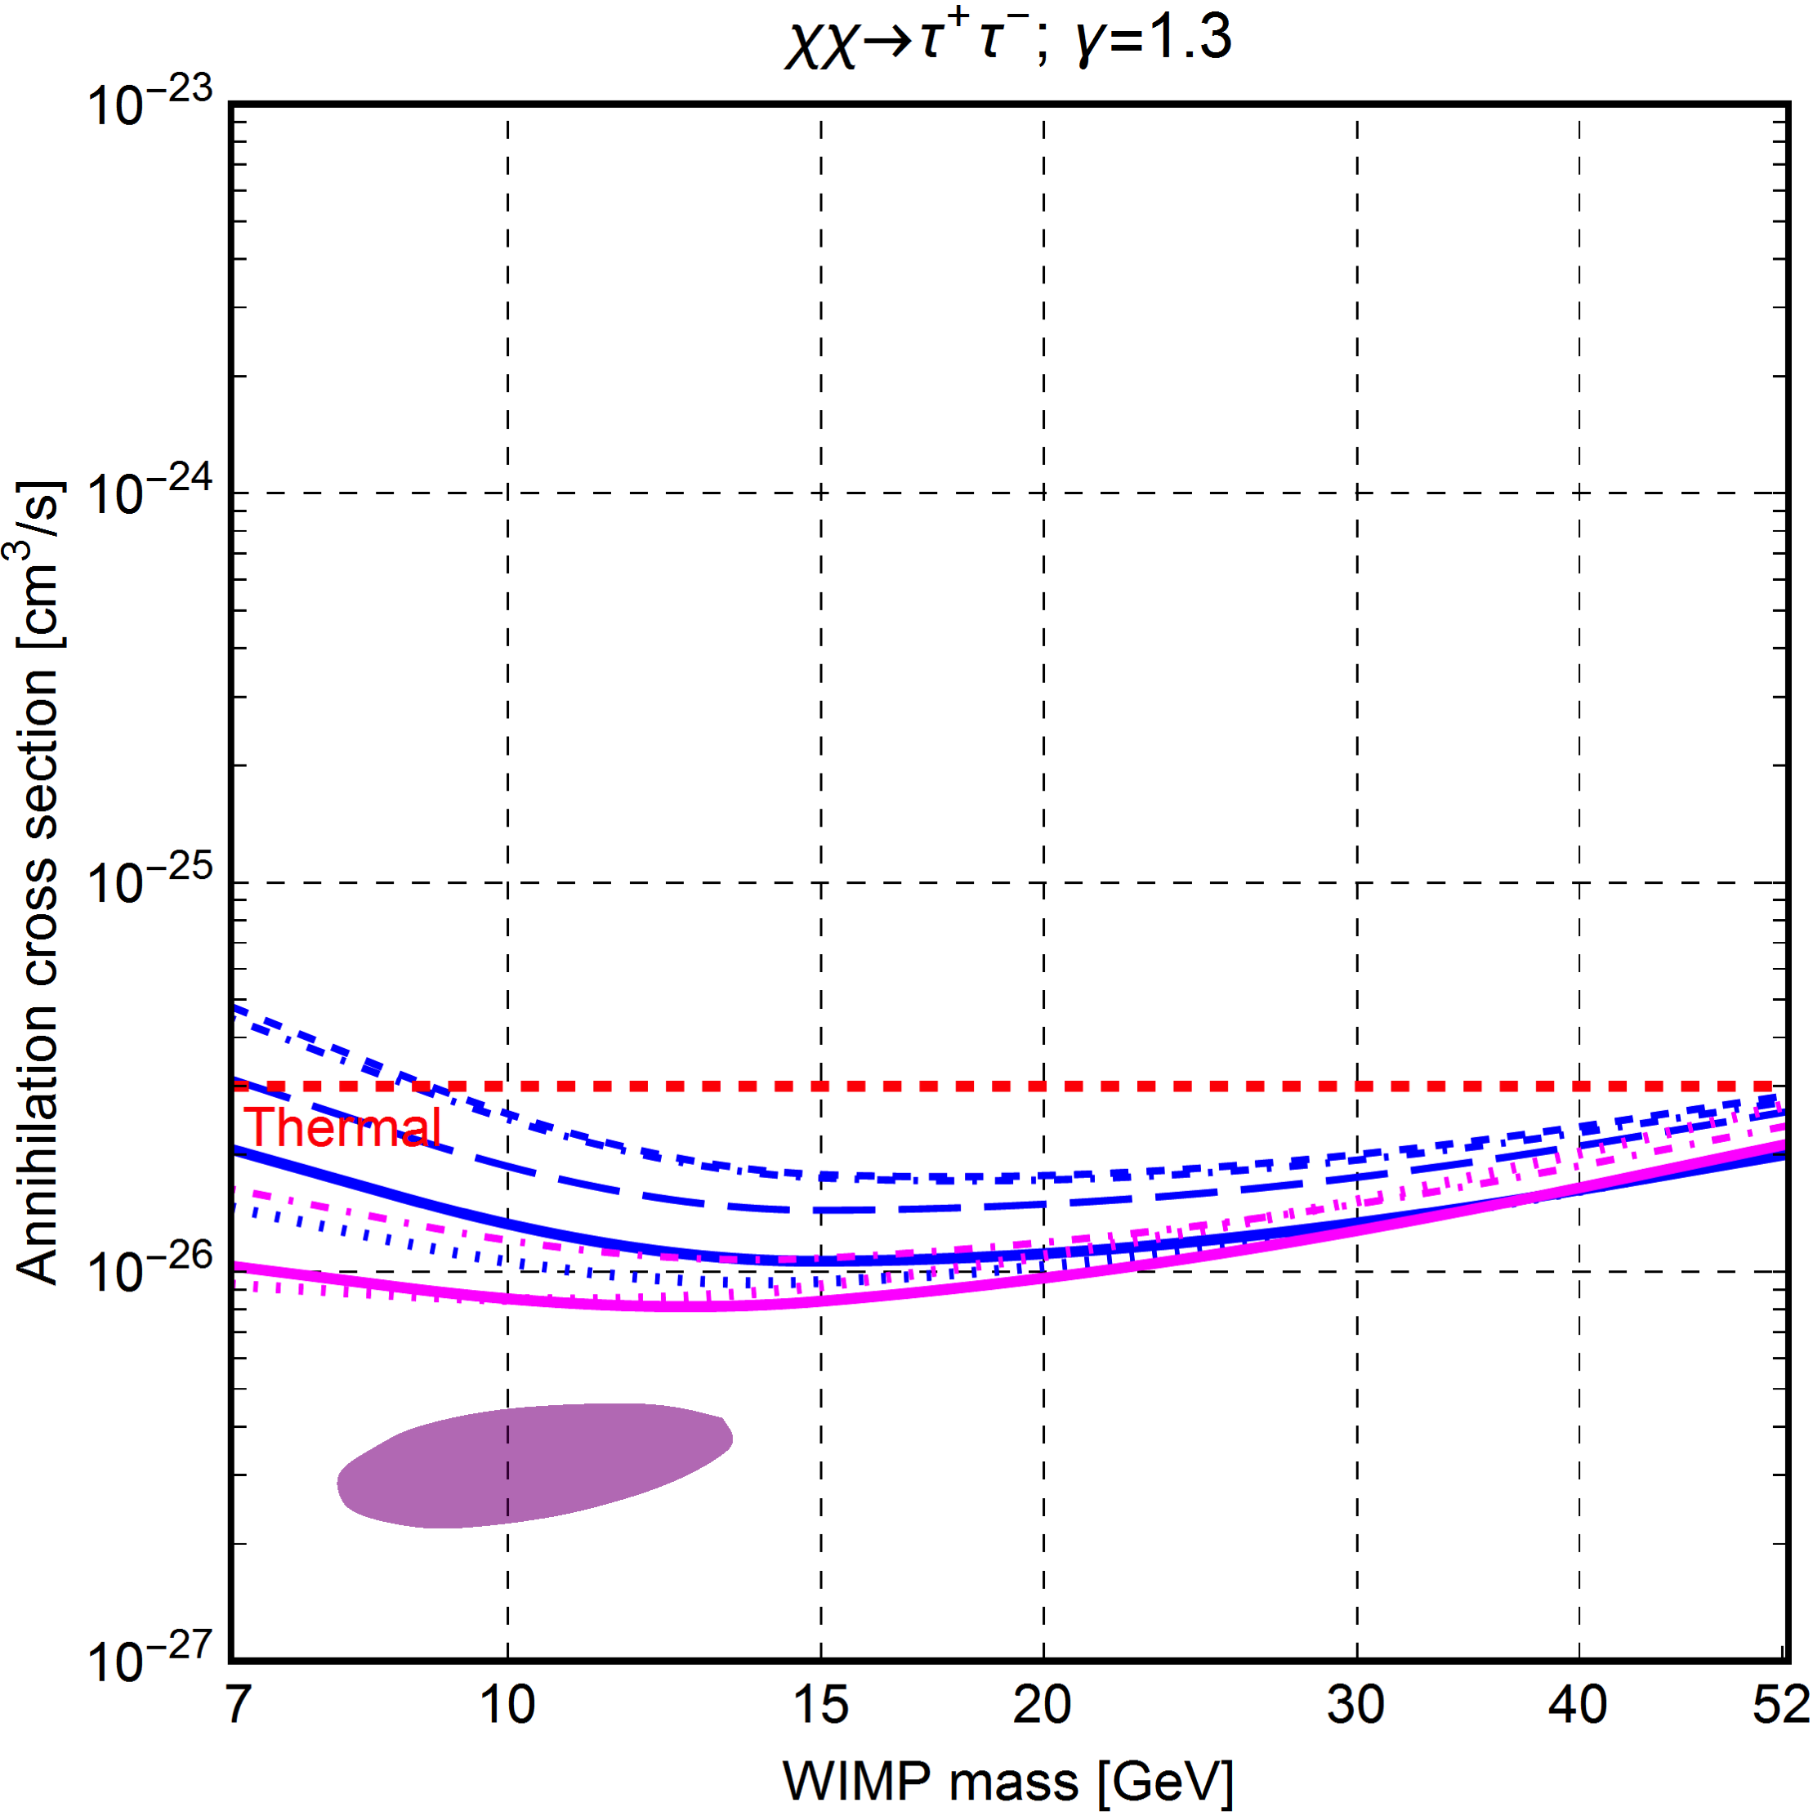
Best fit results: tau+/tau-
“Modeling” induces more spread than statistical uncertainties (too small to see).
Best fits close to canonical cross section, but distant from

Slide 26
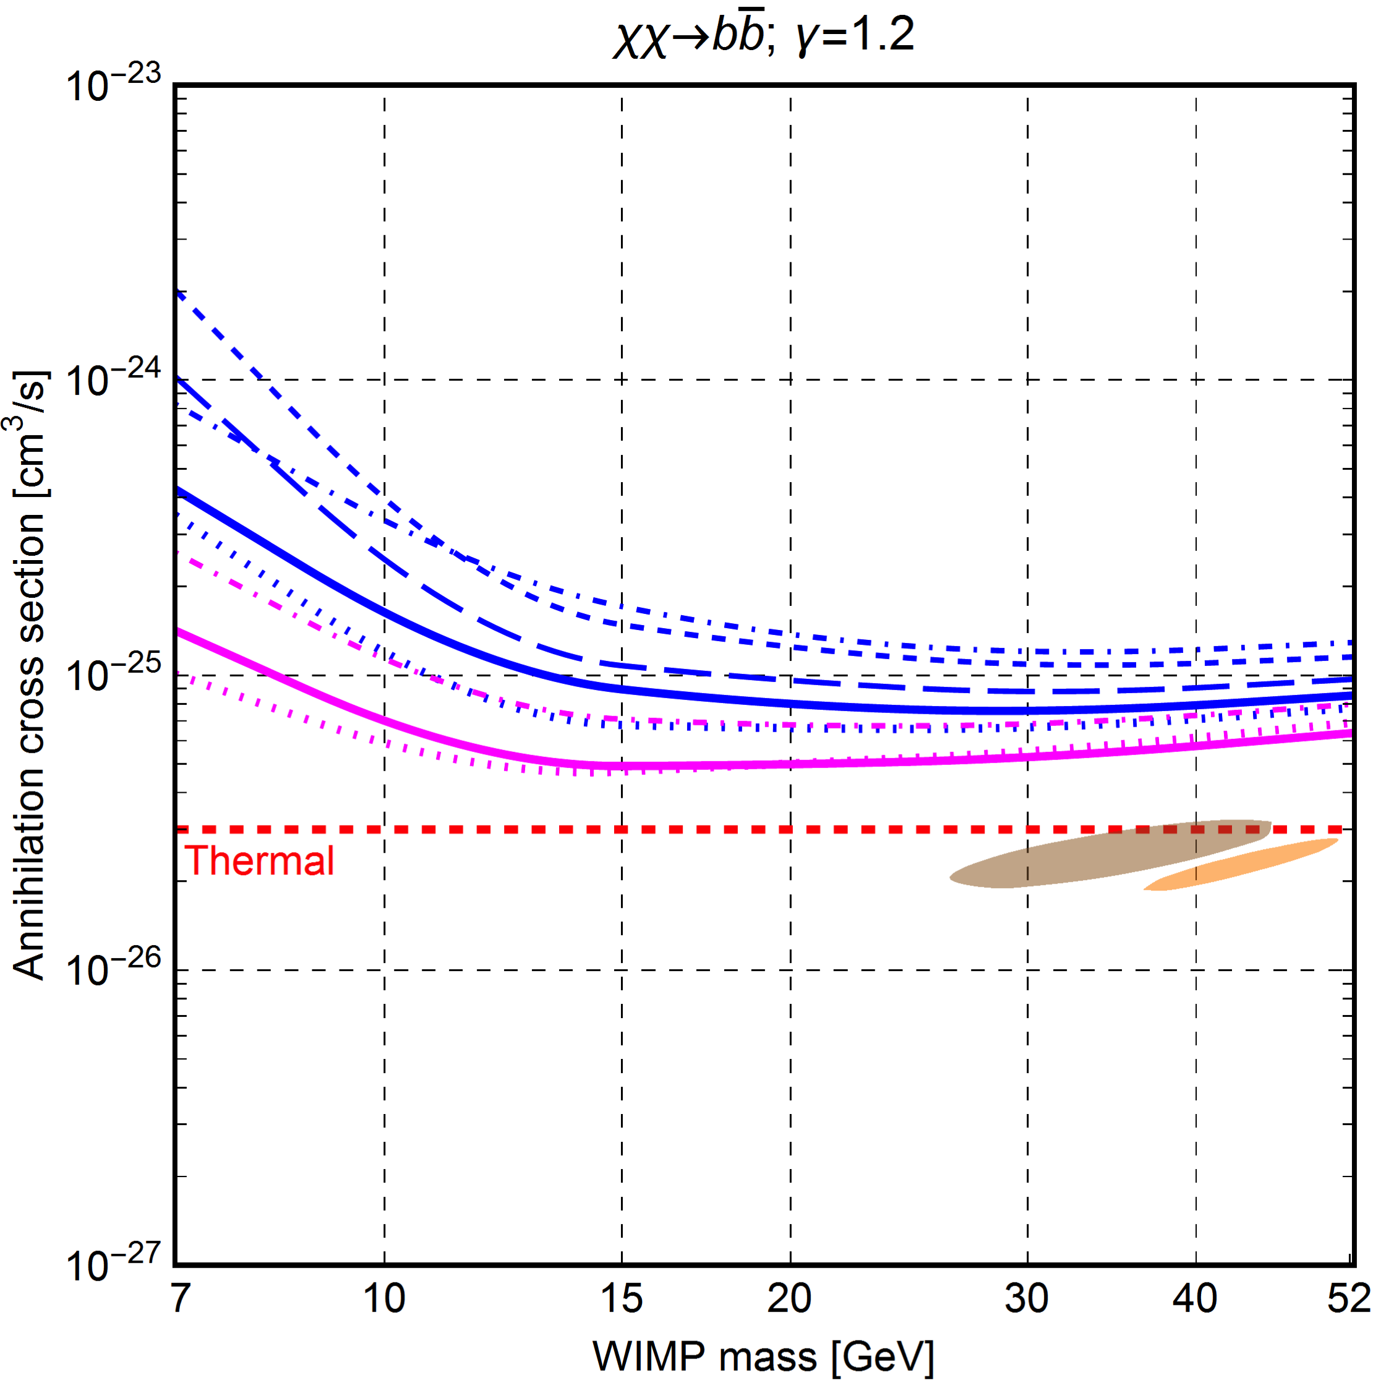
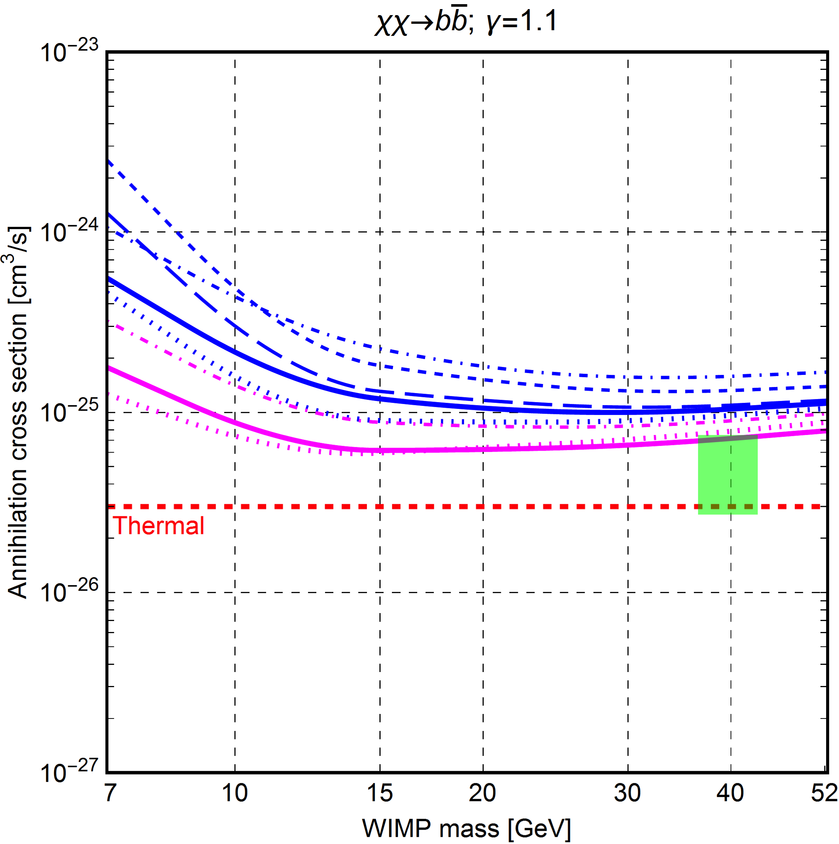
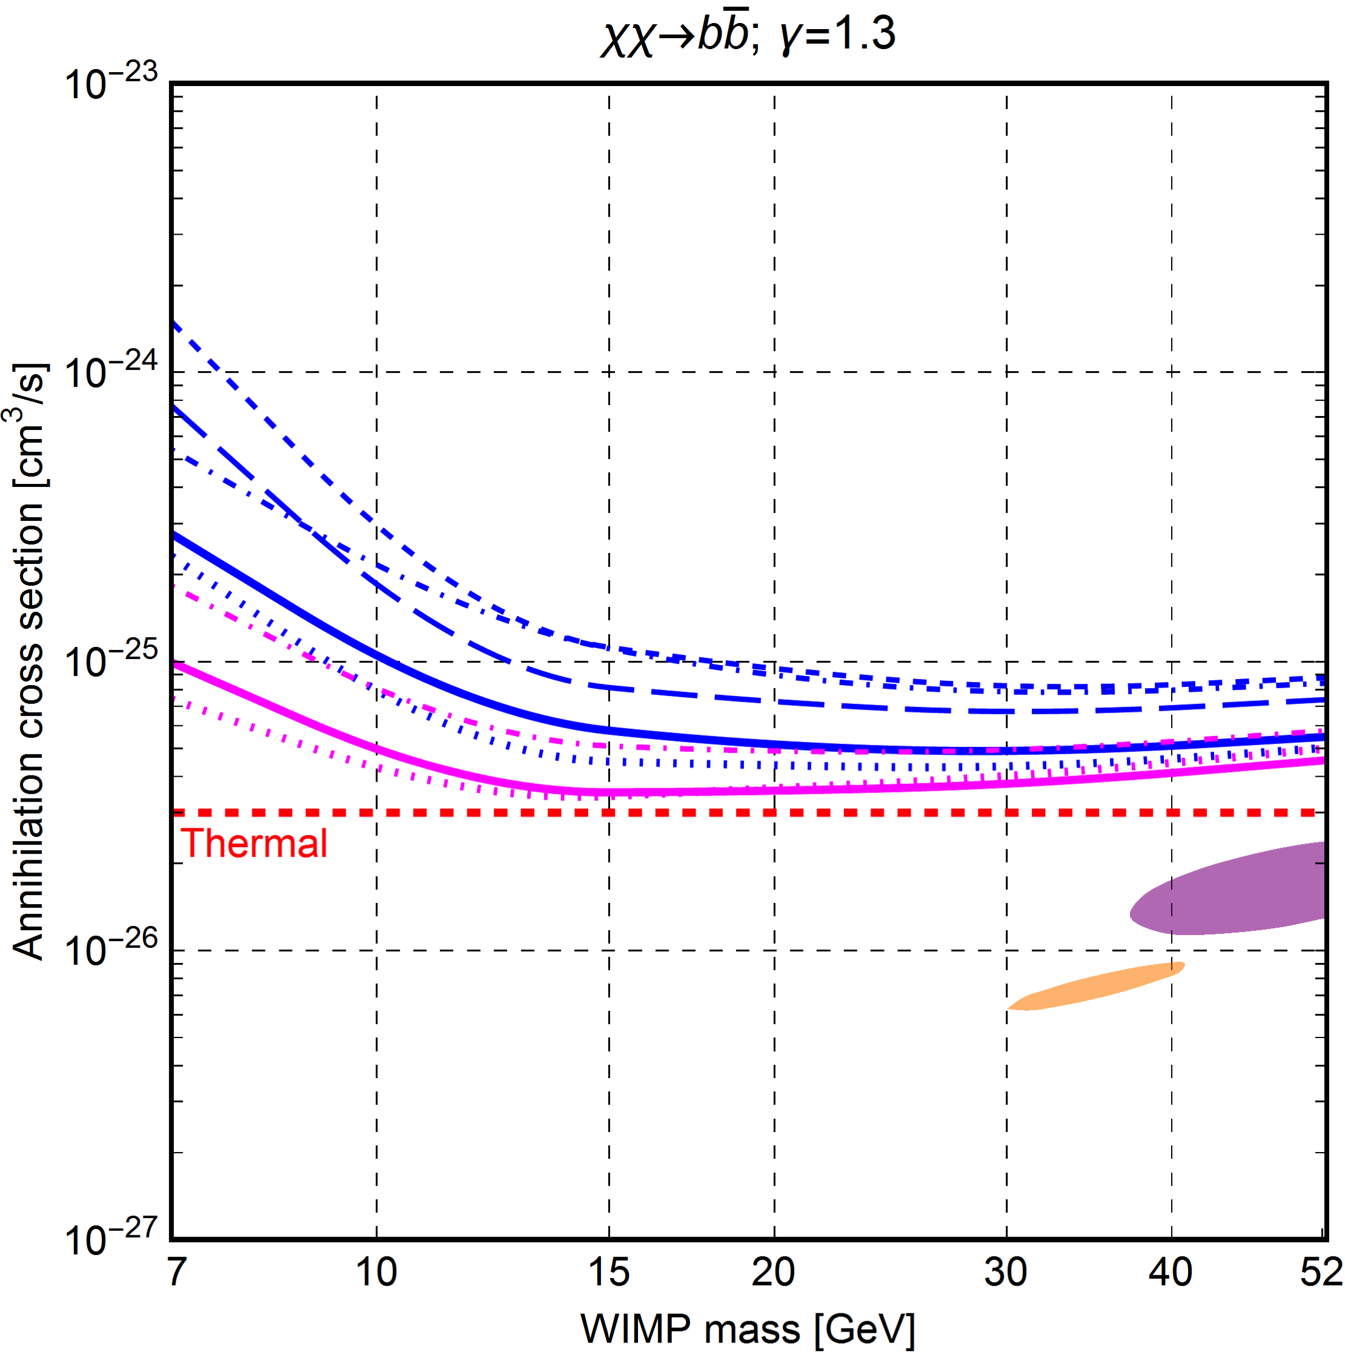
Best fit results: b/b bar
“Modeling” induces more spread than statistical uncertainties (too small to see).
Best fits close to canonical cross section, but distant from

Slide 27
Conclusions
The Haze exists (6-7% of the total signal at 23 GHz) and it has a harder spectrum than usual synchrotron.
Data do not show a preference in fitting the Haze with Bubble or DM. Both produce improvements.
When both included, best fit model has 20-30% of Haze explained by DM.
Some DM model preferred to others. The preferred WIMP cross section does not match those of the gamma-ray excess.
The thermal cross-section, as well as gamma-ray derived cross-sections, are within the most conservative estimates found with Planck maps.
Notes:
Possible questions:
- What is different from Planck analysis?

